Slide 1
UC New Faculty Orientation Research Computing and Data & Advanced Research Computing July 2021
Jane Combs Associate Director, Department of Strategic Programs & Signature Initiatives Research Computing and Data University of Cincinnati Office of Research combsje@ucmail.uc.edu
(513) 556 - 0874

Slide 2
Research Computing & Data (RCD)
RCD provides access to a variety of digital research infrastructure services to faculty, research staff, postdoctoral and graduate students, academic colleges and departments, including the UC College of Medicine.
RCD is a focused researcher-facing team that provides direct outreach, training and resource recommendations to faculty and students, conducts investigation & integration of new technologies, and coordinates between campus technology providers to deliver solutions directly to researchers.

Slide 3
Infrastructure Support for Research Projects
Data Management Planning
Data Collection/Transfer – Network (local and wide)
Data Analysis, modeling, simulation, visualization, AI, Machine Learning
Data Storage, Backup, Recovery
Data Distribution, Sharing, Communication
Collaboration
Documents
Cyberinfrastructure (CI) Plan
Resources and Facilities
Custom Quotes for HPC resources
Credit ARC facility resources

Slide 4
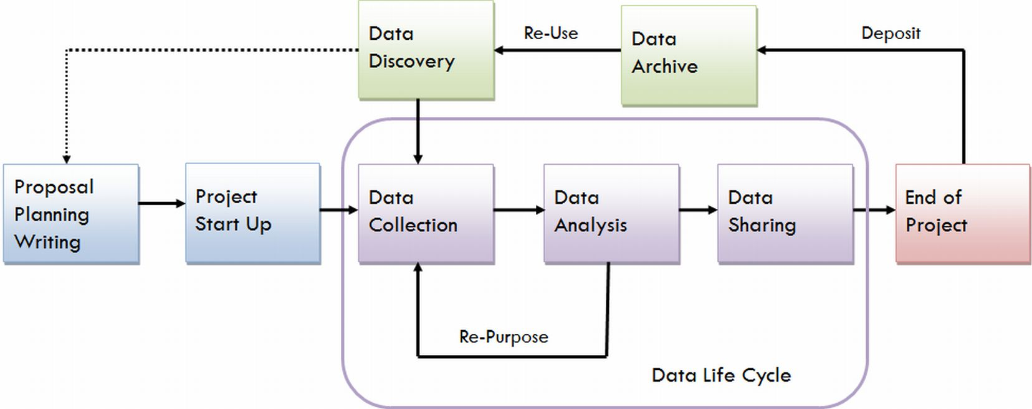
Data Lifecycle – Where do we fit?

Slide 5
Services & Solutions
SERVICE | TOOLS | NOTES¹
Collaboration and Administrative Tools | Sharepoint Web & Teleconferencing solutions WebEx Teams | No charge for these services.
Consultation Hours (in conjunction with FEC) | 2nd Tuesday afternoon & 4th Friday morning | Virtual: by appointment or “walk-in”
Database development & project data management | Interactive web applications Surveys and data Database driven applications App Lab on Main | May incur programming and database charges.
Digital Repository | Scholar@UC | No charge for these services.
Grant support services | Campus Cyberinfrastructure (CI) plan Network diagrams Computing resource costs estimates & technical descriptions Data security & compliance planning | No charge for these services. Email: ucitresearch@uc.edu
High Performance Computing | UC Advanced Research Computing (ARC) Facility ServiceNow ARC access request Ohio Supercomputer Center (OSC) The Extreme Science and Engineering Discovery Environment (XSEDE) resources Jetstream: Cloud-based and on-demand, the 24/7 system includes discipline-specific apps. Cloud services (AWS, Azure, Google) | ARC: nominal charges may apply OSC: charges may apply XSEDE: basic allocations are free to researchers Jetstream: free

Slide 6
Services & Solutions
SERVICE | TOOLS | NOTES¹
Large file transfer | Globus desktop Aspera
Listservs | UC-ARC-HPC UC-RESEARCHCOMP UC_ScienceNet (UCSN) OSC-HPC-USERS DCS2 (Data & Computational Science Series)
Research Data Storage-Enterprise | Isilon Ohio Supercomputer Center (OSC) OneDrive Cloud Storage Services
Science Gateways Community Institute (SGCI) | NSF-funded, online and in person resources and services. Science gateways allow science & engineering communities to access shared data, software, computing services, instruments, educational materials, and other resources specific to their disciplines.
Secure research environment | FISMA, HIPAA, export control, restricted data, encryption, etc.
Servers | Co-located (costs vary) Dedicated (costs vary) Virtual Machines (VM) IT@UC Billing Rates FY21 | VM CPU cost: $18.75 VM memory: $0.37/GB VM storage: $0.14/GB mailto: opensystems-sa@uc.edu

Slide 7
Services & Solutions
SERVICE | TOOLS | NOTES¹
Training & Education (in partnership with UC Libraries, XSEDE and OSC) | Data & Computational Science Series (DCSS) XSEDE monthly HPC workshops OSC workshops at UC: Intro to HPC, Big Data Hadoop/Spark University of Cincinnati Libraries Workshops R, Python, GIS, Data Management, GitHub | No charge for these services. Workshops and seminars at UC are free for UC personnel unless otherwise indicated.
UC ScienceNet (UCSN) | High-speed dedicated research network (10/40 Gbps) | Connections subject to IT@UC charges for data ports. Current locations: CECH; ERC; Rhodes; Braunstein; Geo-Physics; Kettering; Langsam, French Hall West.²
Virtual & Augmented Reality Research & Development | IT@UC Center for Simulations & Virtual Environments Research (UCSIM)
Web/digital content | Branding, short URLs, content management, SEO, social media, etc.
Websites | UC Homepages (C-panel) | No charge for these services.

Slide 8
Advanced Research Computing (ARC) What is ARC?
High performance and high throughput computing facility
enables and accelerates computational research
develops a computational workforce of HPC professionals
educates emerging computational researchers
ARC team
faculty advisory committee (members from CEAS, CoM, A&S, CoB)
Office of Research
IT@UC
HPC administrators and user support personnel
supported by IUIT and NSF XCRI chief architect and administrators

Slide 9
Available Hardware
ARCC 2 – Available July 2021
CPU
70 CPU Nodes will have:
Two AMD EPYC 7452 CPUS, each with:
32 cores
2.35-3.35GHz
960GB SSD
256GB of RAM
InfiniBand 100Gb/s
Large Memory node
# TBD, Each of the large memory nodes will consist of:
Two AMD EPYC 7452 CPUS, each with:
32 cores
2.35-3.35GHz
960GB SSD
1TB of RAM
InfiniBand 100Gb/s
GPU
~7 GPU nodes will have:
Two NVIDIA Tesla A100 40GB GPUs
Two AMD EPYC 7452 CPUS, each with:
32 cores
2.35-3.35GHz
960GB SSD
512GB of RAM
InfiniBand 100Gb/s
ARCC 1
CPU
The 36 CPU nodes contain:
Two Intel Xeon Gold 6148 CPUS, each with:
20 cores
2.4-3.7GHz
192GB of RAM
Omni path 100GB/s
GPU
The GPU node contains:
Two NVIDIA Tesla V100-32GB GPUs
Two Intel Xeon Gold 6148 CPUs:
20 cores
2.4-3.7GHz
192GB of RAM
Omni path 100GB/s

Slide 10
Available Software
OpenHPC environment
Warewulf cluster provisioning system and managed by the SLURM
Developmental tools, including compilers, OpenMP, MPI, OpenMPI libraries for parallel code development, debuggers, and open source AI tools
FLEXlm being installed so that individual researchers can easily maintain and use their software resources
User login is based on UC/AD, so that user groups and easier access

Slide 11
Available Software
Intel compilers | 2013.1.117, 2018.2.199, 2019.4.243
Intel MPI | 5.0.3.049, 2018.2.199
Julia | 1.3.0
MATLAB | 2018b, 2019a
Maxquant | 1.6.17
Numeca | 12.2, 13.2, 14.1
OpenMPI | 1,6.5, 2.1.2, 3.0.4, 4.0.0
Pmix | 2.2.2
Prun | 1.3
Silo | 4.10.2
Singularity | 3.4.1,3.7.1
Star CCM | 12.02, 13.06, 14.06, 15.02, 15.04
T_Blade | 3
Software | Version Available
Abaqus | 2016, 2018
Anaconda | 2.0, 3.0
ANSYS | 19.2, 21.0
Cantera | 2.4.0
Cmake | 3.15.4
Cp2k | 7.1
Dakota | 6.9, 6.11
GNU Compilers | 5.4.0, 7.3.0, 8.3.0
Gromacs | 2019.2
Hwloc | 2.1.0

Slide 12
Other Services
User training and support
Data & Computational Science Series
E.g., Linux 101, HPC 101, XSEDE monthly HPC workshops
installation of codes
Procurement and consulting
cheaper negotiated rates for faculty who would like to purchase hardware
software consulting
installation in the ARC with 24x7 data center operations (no worries about cooling, power, racks, head node, etc.)
Commodity services
high-speed data transfer through UCSN and OARnet (10-40 GB/s)
high-speed scratch storage
back-up, recovery and data security

Slide 13
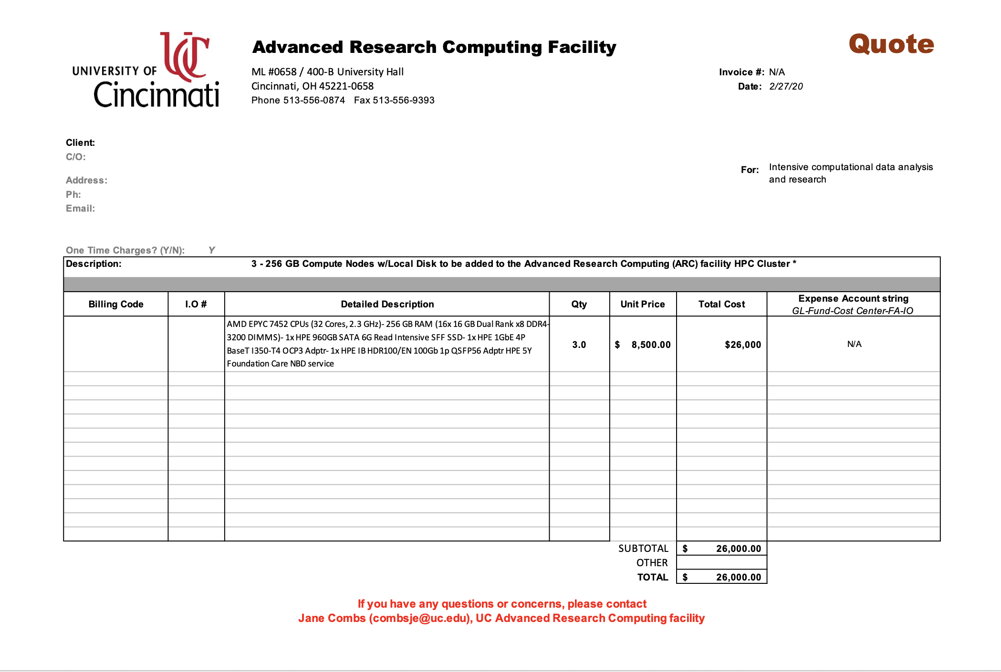
Custom Quotes for Grant Proposals

